Slide 1
South America
A detailed Data Analysis
Team 6
November 5th, 2019

Slide 2
Agenda
1
Overview
2
Differences
3
Countries
4
Conclusion / Recommendations
5
Q/A

Slide 3

South America
Curacao
Venezuela
Colombia
Guyana
Ecuador
Suriname
Peru
Brazil
Paraguay
Bolivia
Uruguay
Chile
Argentina

Slide 4
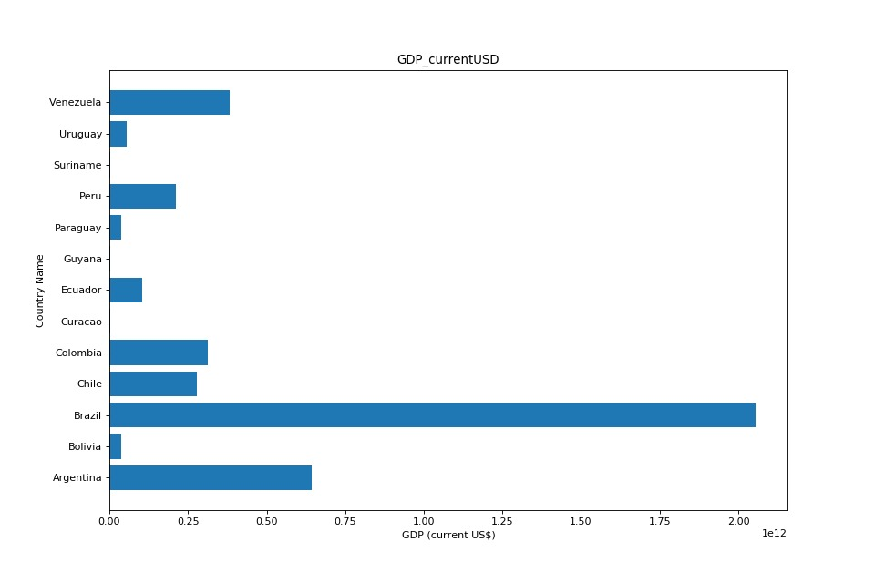
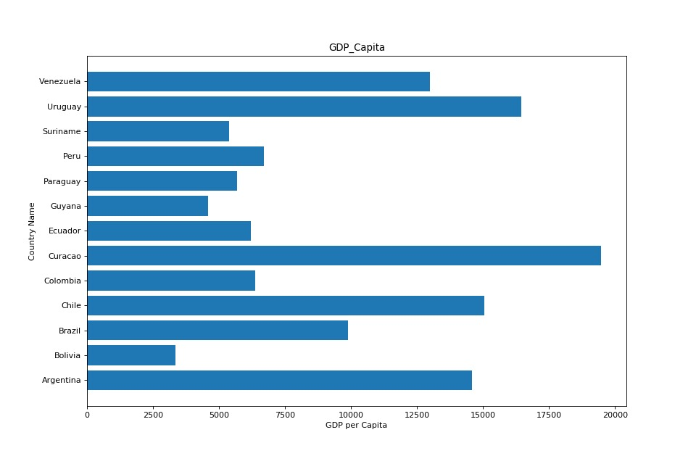
Economic Activity
South America
Notes:
Clear difference between GDP per capita and overall country's GDP.
Largest GDP in South America is Brazil, followed by Argentina, two countries with the largest populations.
Once you split down the GDP per person the wealth structure changes, with Curacao, Uruguay and Chile being the wealthiest countries.

Slide 5
Agenda
1
Overview
2
Differences
3
Countries
4
Conclusion / Recommendations
5
Q/A

Slide 6
South America at a Glance
Similarities
GDP
2.08% avg growth
1.6% avg military expenditure
Access to Electricity
98% of all urban and rural populations
Population
0.89% average population growth
6.78 deaths (per 1000 people on average
2.17 births per woman on average
Notes:
Similarities between countries in South America can be categorized in 3 groups:
- access to electricity, where in average 98% of all urban and rural populations in these countries have access to electricity
- population, with an average of 0.89% population growth, 6.78 deaths per 1000 people and 2.17 births per women
- GDP, with 2.08% average growth within these countries and 1.6% average military expenditure as percentage of GDP

Slide 7
South America at a Glance
Differences
Economy
Countries either focus on manufacturing and exports or on providing services
Employment
Employment varies within countries from agriculture to services
Education
Differences on educational attainment depending on overall wealth of the country
Notes:
Differences between countries in South America can be categorized in 3 sectors:
- Industry, because some countries strongly rely on agriculture, manufacturing and exports, and usually are the poorest countries in our area, while others focus more on providing services, and in average tend to be the richest countries
- education, as there are differences in educational attainment per country depending on the overall wealth and also differences on the quality of education provided
- employment, since this varies from country to country depending on whether their economy focuses more on agriculture or services.

Slide 8
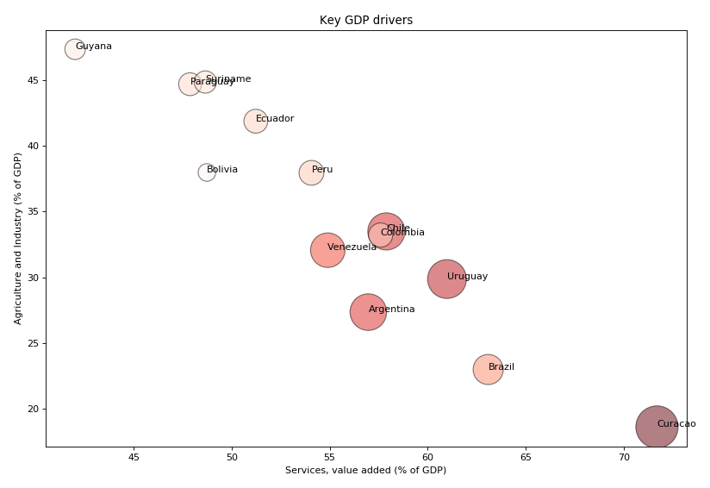
Countries' key sources of income determine wealth per capita
Notes:
- There is a clear correlation showing that the countries that rely more on agriculture and industry as a percentage of GDP invest less on services. It is also interesting to notice that the countries that base their economy on agriculture are the poorest and underdeveloped in South America, while the richest countries tend to have a more service-oriented economy.

Slide 9
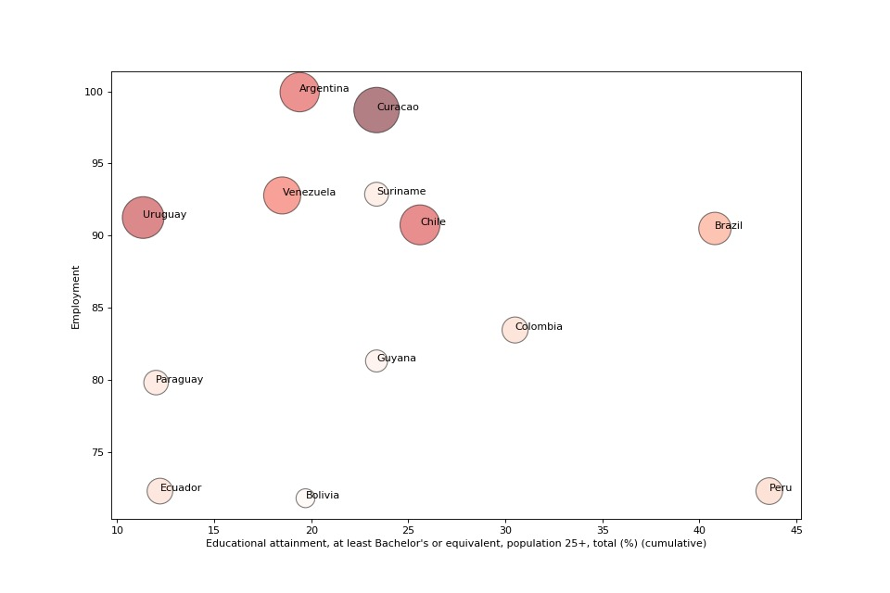
Degrees of education differ widely across countries but do not form a strong correlation to employment
Notes:
The graph shows that employment doesn’t necessarily depend on education but depends on the economic situation of the country.
The higher skilled labor is, the more likely it is to be employed, this is shows because the
Peru is outlier: Peru’s quality of education is very bad and the skills mismatch leads to fewer jobs
Argentina: while sources say Argentina’s unemployment rate is 8.35%, world bank data shows a 99% employment when adding service employment & industry employment

Slide 10
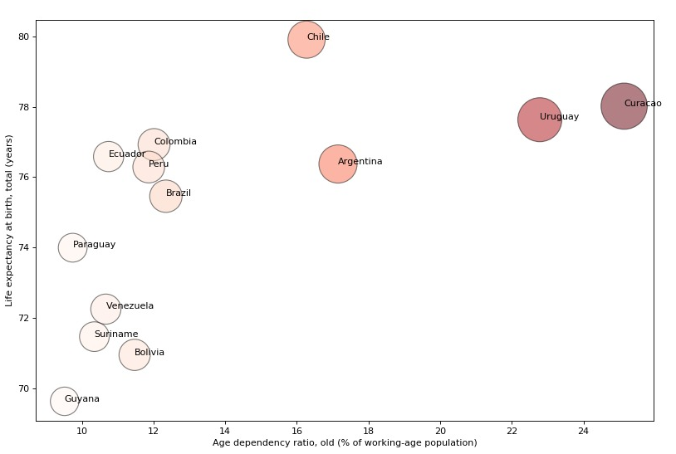
Life expectancy at birth correlates strongly with the age dependency ratio of old with a 64% correlation
Notes:
Graph shows a correlation between the ratio of old people in the country and the life expectancy at birth. This means that the countries which have a higher ratio of old people in their population have a higher life expectancy at birth than the countries who have a lower ratio of elder people.
Moreover, the countries with higher ratio for older people are also the wealthier and with higher GDP per capita.
However, we have not adjusted for inflation in correlation due to lurking variables such as crime rates etc.

Slide 11
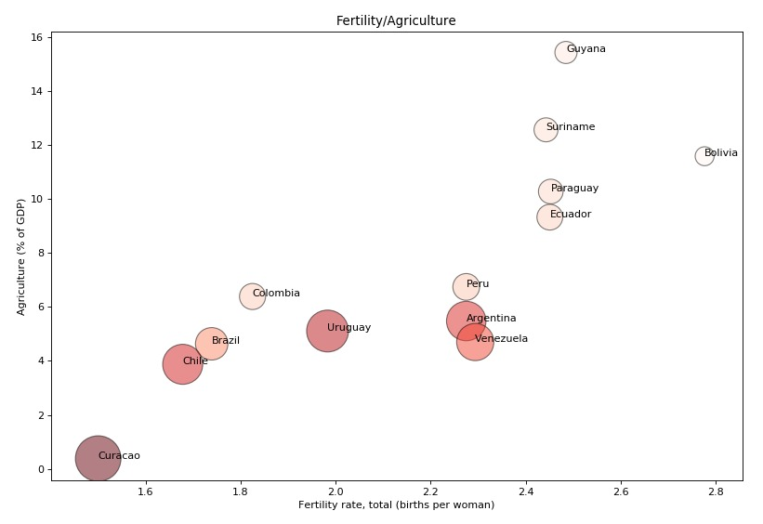
Fertility rates and importance of labor intensive sectors show a 82% correlation
Notes:
- There is a clear correlation between agriculture as percentage of GDP and fertility rate. This shows that the more the country's economy is agriculture oriented, the more births a woman will have in average.

Slide 12
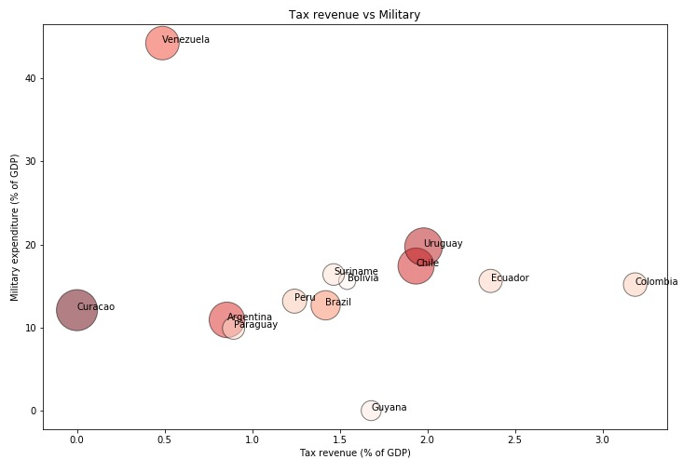
While government military expenditures (in % of GDP) average around the same, governments' tax income vary widely
Notes:
- There is a clear variation between the countries' tax revenue, when the military expenditures average of all is similar.
Here you can see an obvious outlier – Venezuela. That has a high military expenditure but a relatively low tax revenue.
80% of Venezuela's budget comes from the oil industry, with less oil more taxes. During 2016-2017 we assume the oil industry was still sustaining the country's budget.
And because of the political situation with Maduro and the Supreme Court taking over the National Assembly, there was a lot of protestants during 3 months in 2017, that was handle by the military. Maduro has also give more privileges to military to keep their loyalty.
Columbia: high tax rate largely caused by the new wealth tax implemented by President Juan Manuel Santos at the end of 2014, designed to increase revenue for the government in order to close the 2015 budget, which fell short largely due to falling oil prices and a sharp decline in revenue from Colombia’s top export, crude oil

Slide 13
Agenda
1
Overview
2
Differences
3
Countries
4
Conclusion / Recommendations
5
Q/A
Notes:
MAKE HYPERLINKS AGAIN –cause Alaska deleted them! >_> -

Slide 14
Countries performing worst economically and showing the largest outliers, tend to be agriculture and manufacturing intensive countries, tainted by corruption or political unrest
Bolivia
Guyana
Suriname
Venezuela
Economy strongly oriented to trade
46.9% of GDP derives from natural resources exports, which have been nationalized in 2007
Lacks Highly Skilled Labor
Struggles with quality education, corruption, sinking exports and rising imports
Highly dependent on commodity exports
90% of forex earnings and 45% of government revenues are from exports
Economic and political crisis
Oil industry collapsing.
Opposition to current president.
Food and health resources shortage
Notes:
- There is a clear correlation

Slide 15
Agenda
1
Overview
2
Differences
3
Countries
Conclusion / Recommendations
4
5
Q/A
Notes:
MAKE HYPERLINKS AGAIN –cause Alaska deleted them! >_> -

Slide 16
Recommendations
The Service Sector is the Money Maker
Countries with a focus on providing services tend to have a higher GDP per capita
Education creates Opportunity
An increase in skilled labor allows countries to invest in the service market
1.
2.
Focus on Guyana
Guyana’s GDP is expected to grow by 86%. This is due to large oil deposits discovered off the coast.
3.
Notes:
The Service Sector is the Money Maker
Countries with a focus on providing services tend to have a higher GDP per capita than countries with an export-oriented economy
Education creates Opportunity
While a high quality of education does not guarantee jobs, an increase in skilled labor allows countries to invest in the service market

Slide 17
Thank you
We're open for questions

Slide 18
Agenda
1
Overview
2
Differences
3
Countries
4
Conclusion / Recommendations
5
Q/A
Notes:
MAKE HYPERLINKS AGAIN –cause Alaska deleted them! >_> -

Slide 19
Back UP
All Sources

Slide 20
Missing Data
How we dealt with missing data
Identify Missing Values
1. Use Python to calculate % of missing value
- Sort missing values by percentage
Drop Values
2. Use Python if the missing value count is greater than 5
- drop those column
Calculate Missing Values
3. Populating Values using data found online
4. Using Python to calculate missing values:
- Replace by average if there are no extreme values
- Columns with extreme values – used group average
- Grouping done by dividing countries lower and upper, cutoff at 10,000

Slide 21
Outlier Facts
What are the reasons for our Outliers?
Peru
Peru’s quality of education is very bad and the skills mismatch leads to fewer jobs
Argentina
While sources say Argentina’s unemployment rate is 8.35%, world bank data shows a 99% employment when adding service employment & industry employment
Chile
80% Life expectancy due to: access to sewerage, to drinking water, the end of malnutrition and increase in vaccine use

Slide 22
Outlier Facts
What are the reasons for our Outliers?
Colombia
high tax rate largely caused by the new wealth tax implemented by President Juan Manuel Santos at the end of 2014, designed to increase revenue for the government in order to close the 2015 budget, which fell short largely due to falling oil prices and a sharp decline in revenue from Colombia’s top export, crude oil

Slide 23
Correlation Matrices

Slide 24
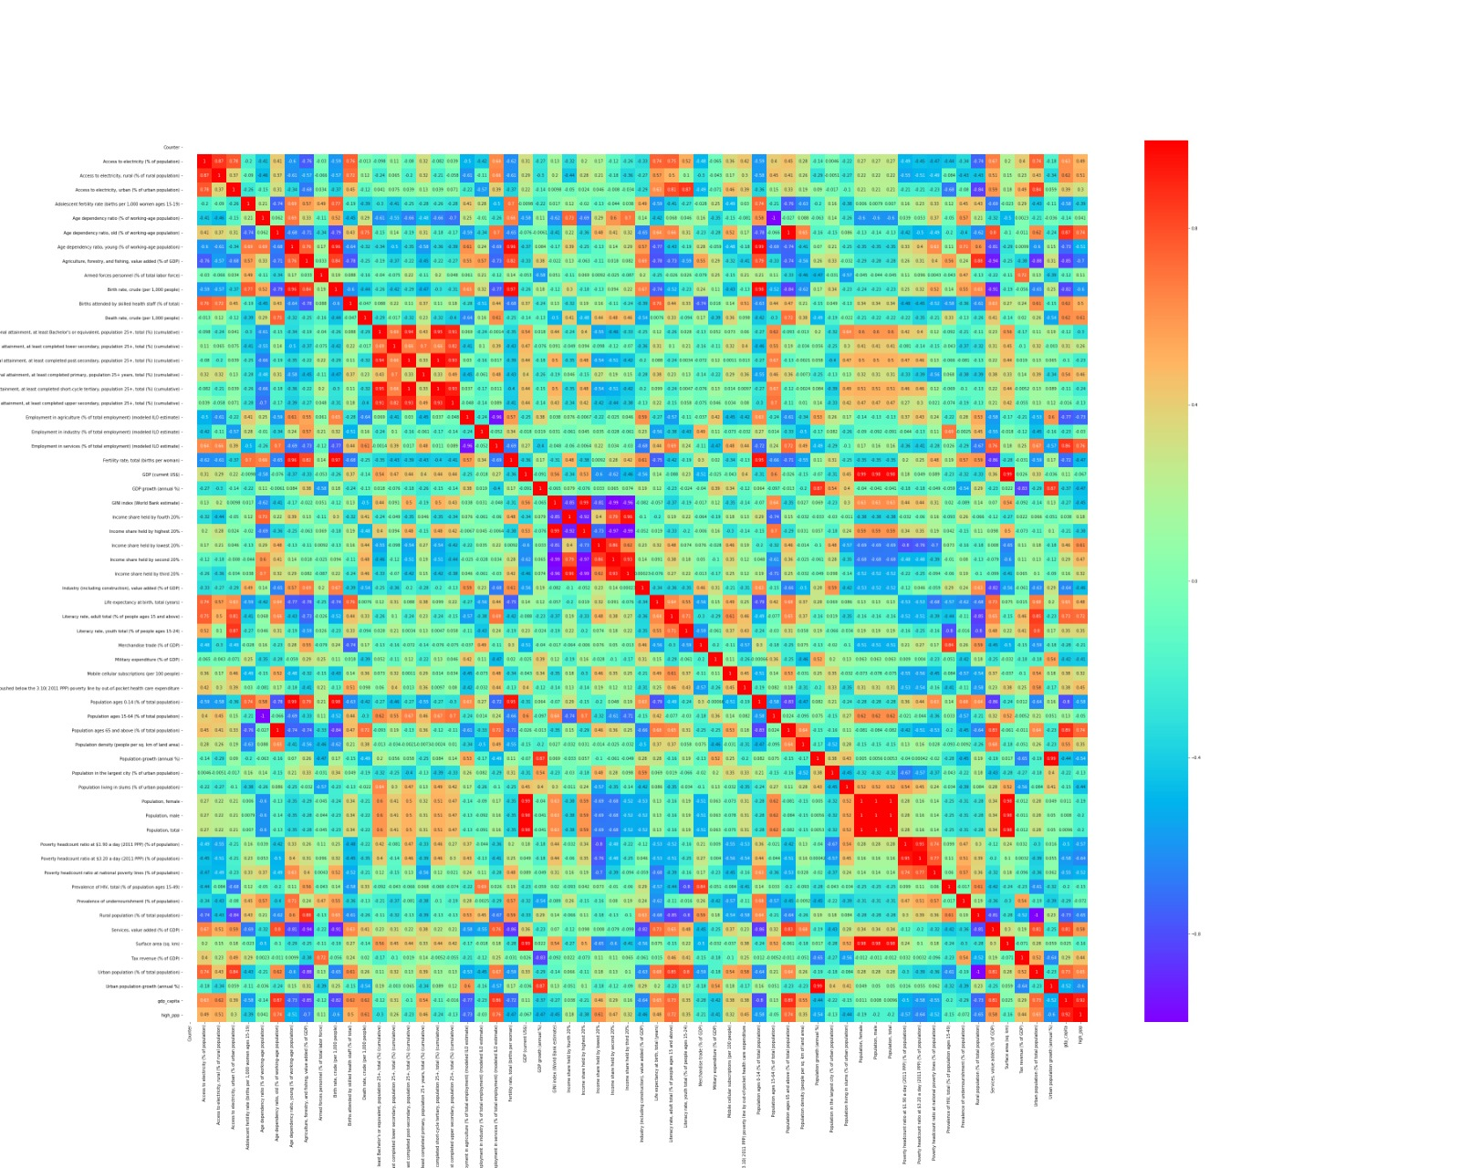
Correlation Matrix
All Data
Notes:
- There is a clear correlation

Slide 25
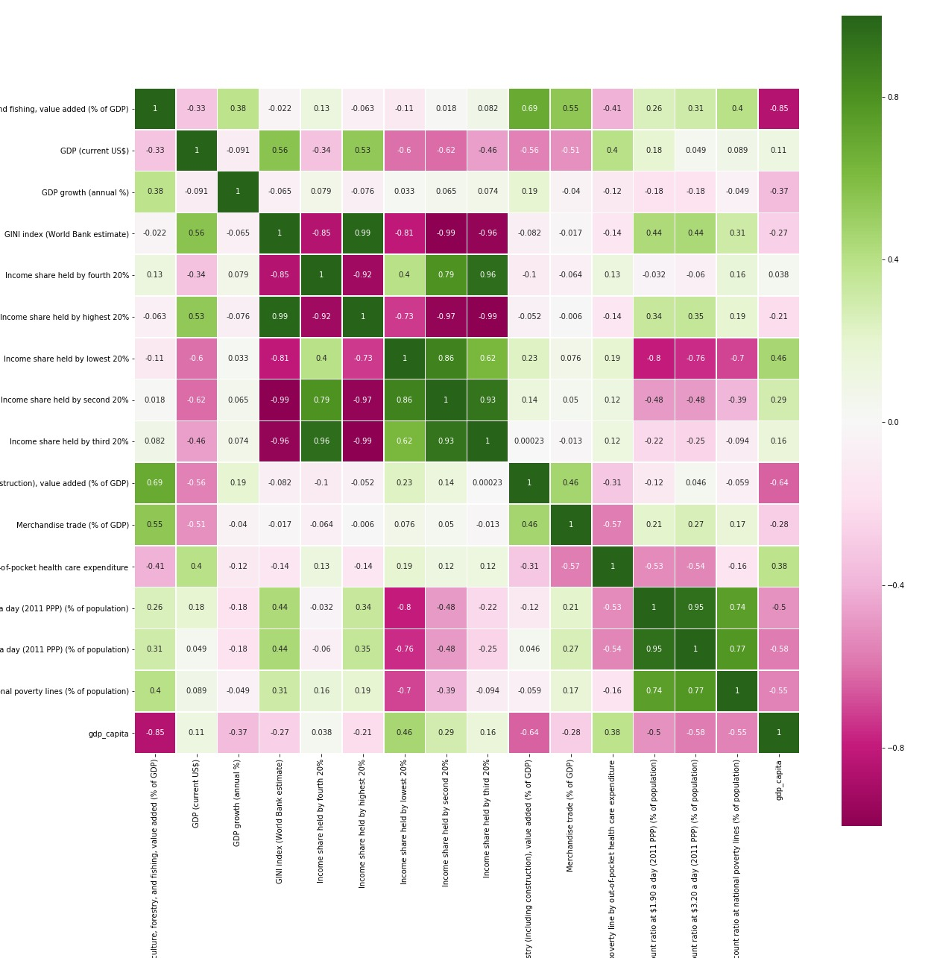
Correlation Matrix
Economy
Notes:
- There is a clear correlation

Slide 26
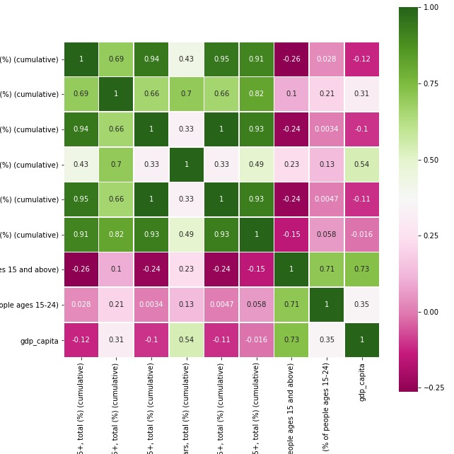
Correlation Matrix
Education
Notes:
- There is a clear correlation

Slide 27
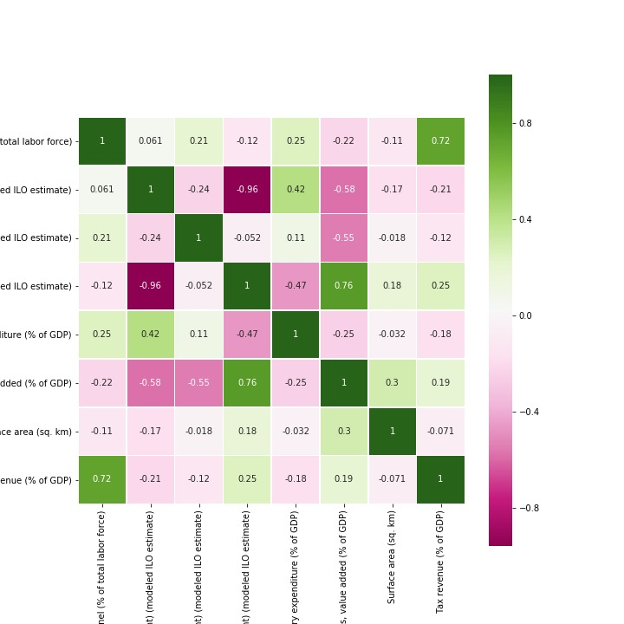
Correlation Matrix
Employment
Notes:
- There is a clear correlation

Slide 28
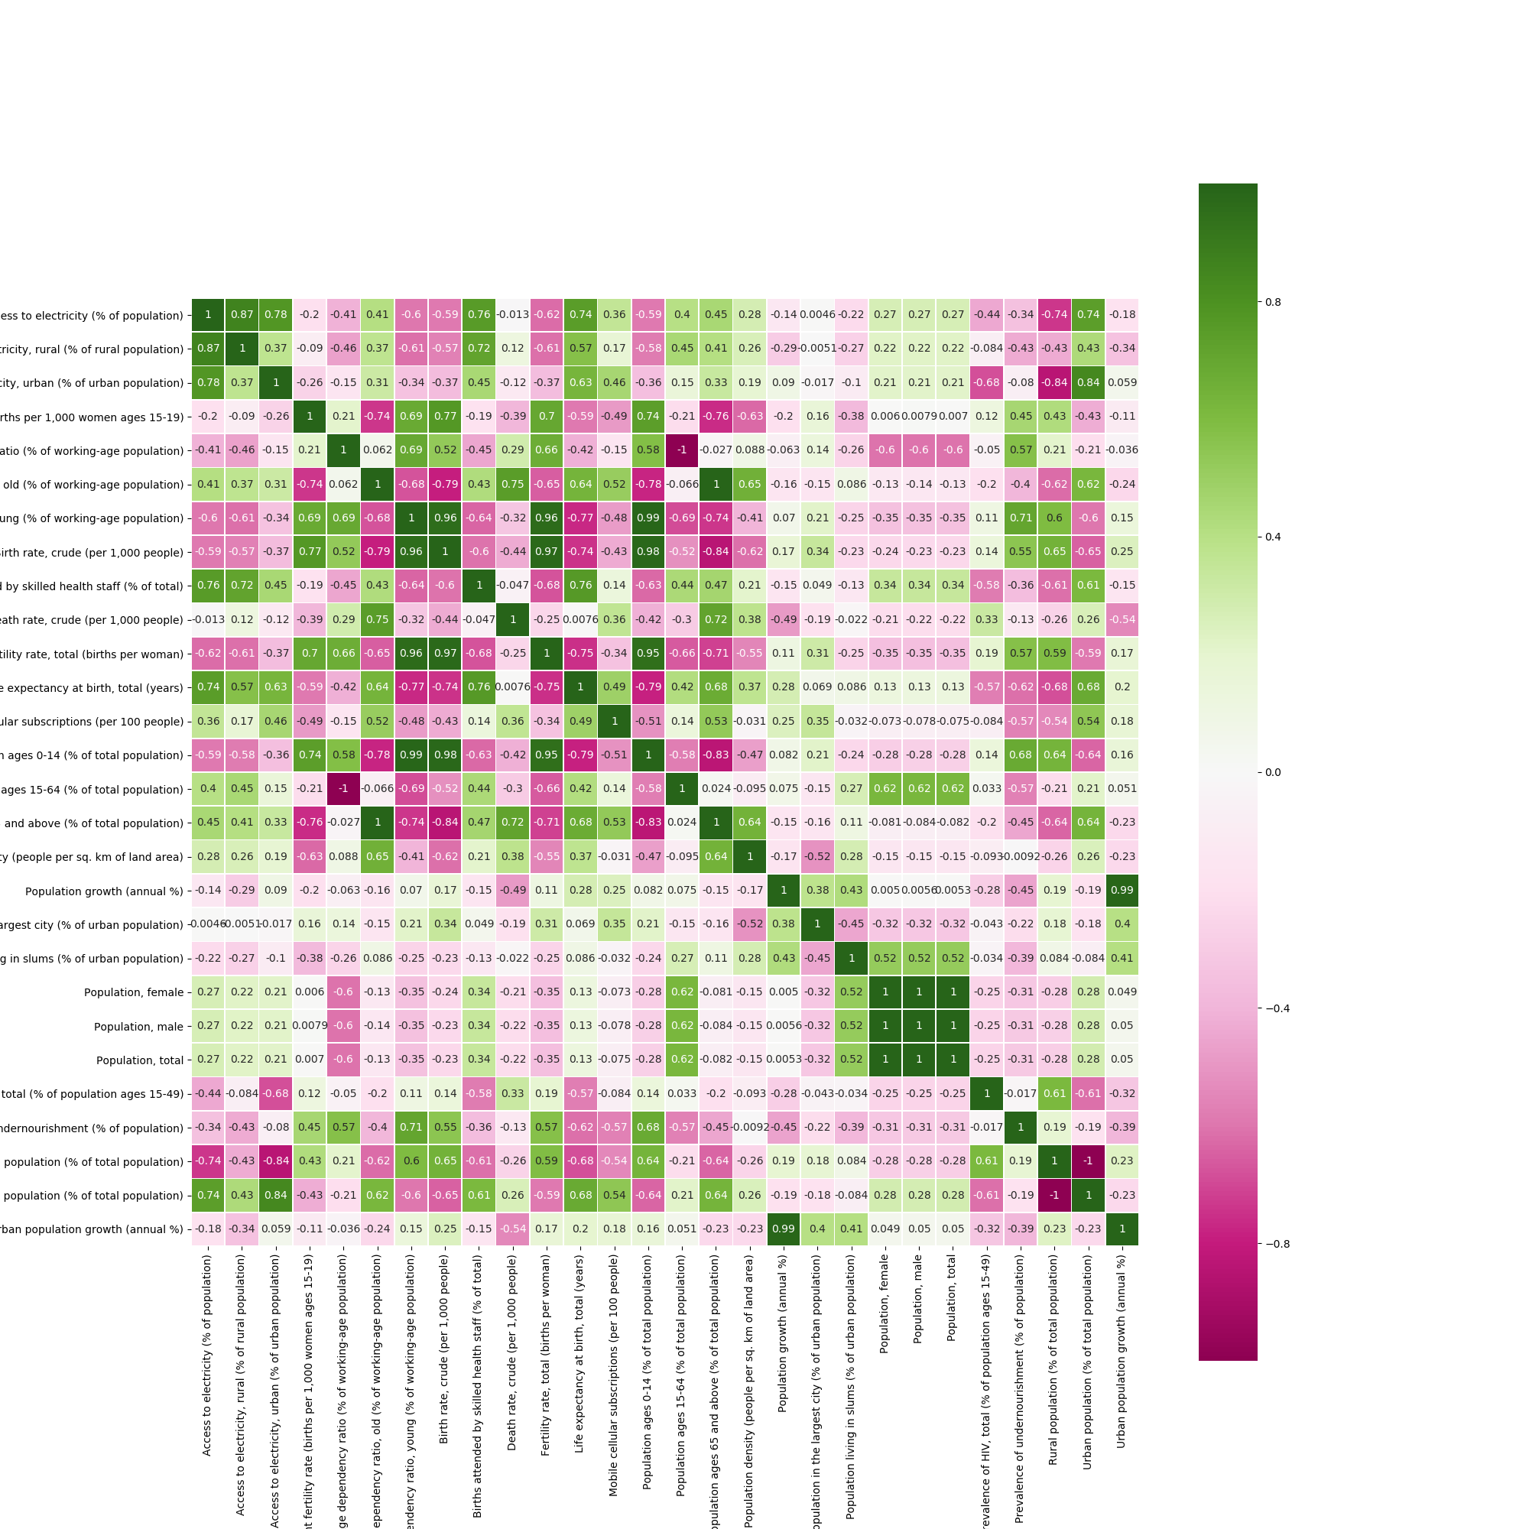
Correlation Matrix
People
Notes:
- There is a clear correlation

Slide 29
Ratios

Slide 30
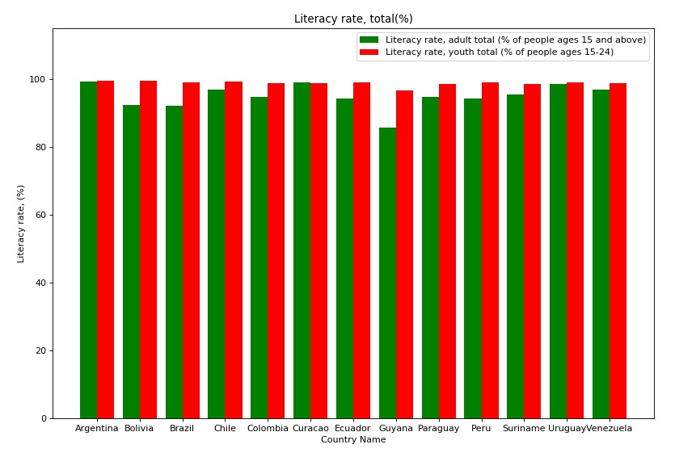
Literacy Rate Countries
Notes:
- There is a clear correlation

Slide 31
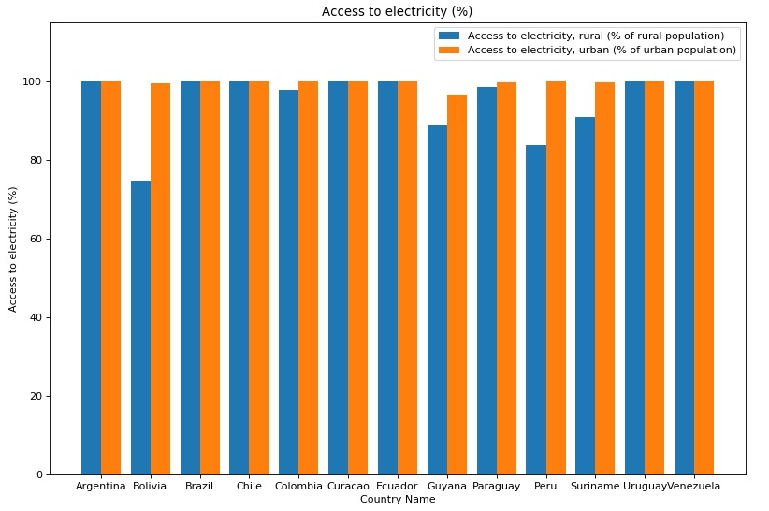
Access to Electricity Countries
Notes:
- There is a clear correlation

Slide 32
Comparisons between countries

Slide 33
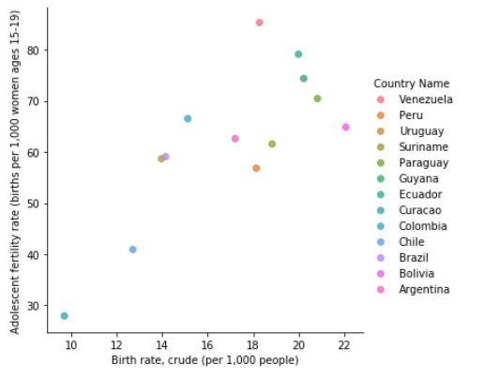
Birth rate x Adolescent fertility
Notes:
Clear relation between adolescent fertility rate and the birth rate.

Slide 34
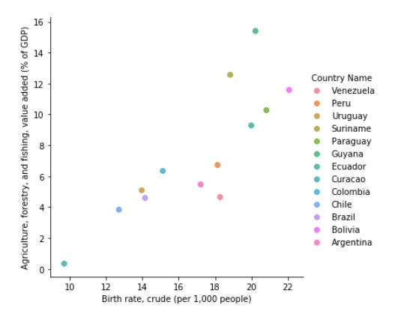
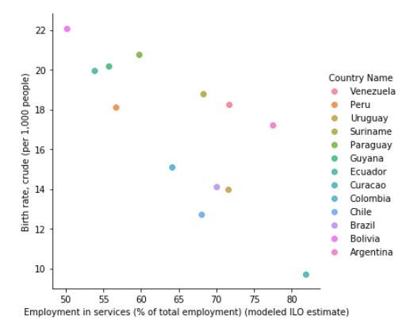
Birth rate x
Employment in services & Agriculture, forestry and fishing GPD
Notes:
The higher the portion of GDP comes from agriculture, forestry and fishing, the highest the birth rate.
The highest the employment in services, the lower the birth rate.

Slide 35
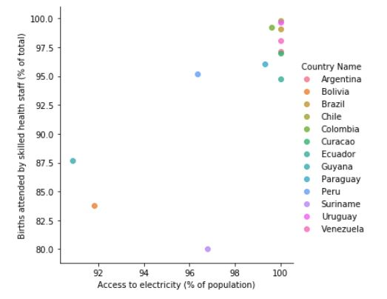
Access to electricity total x Births attended by skilled health staff
Notes:
Assumption: The more access to electricity more adequate facilities for delivery and more skilled staff attending them.

Slide 36
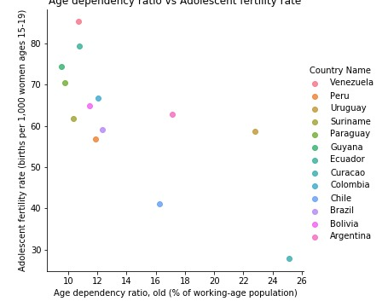
Adolescent fertility rate x Age dependency ratio

Slide 37
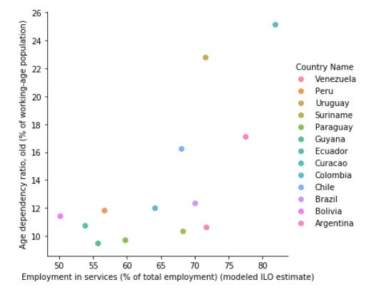
Employment in services x Age dependency ratio, old.
Notes:
The highest the % employment in services, the less the age dependency ratio, old. With two outliers.

Slide 38
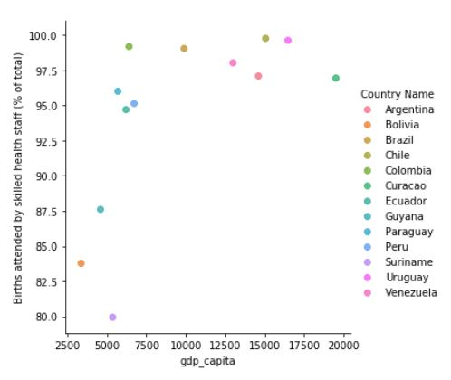
GDP per capita x Births attended by skilled health staff
Notes:
The higher the GDP per capita, the higher the births attended by skilled health staff.

Slide 39
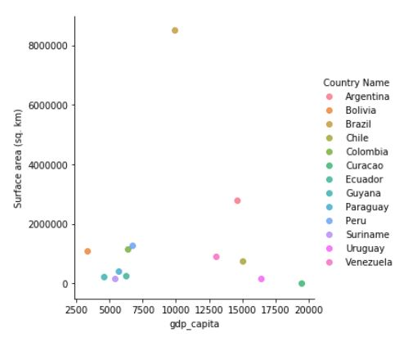
GDP per capita x Surface area

Slide 40
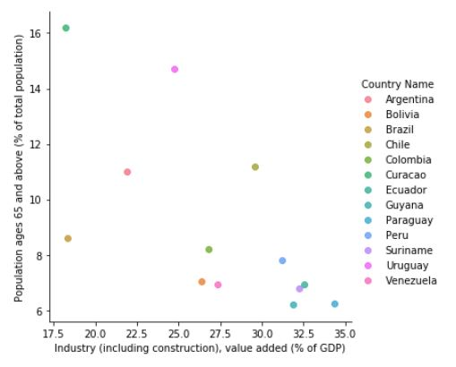
Industry GDP x Population ages 65 and above

Slide 41
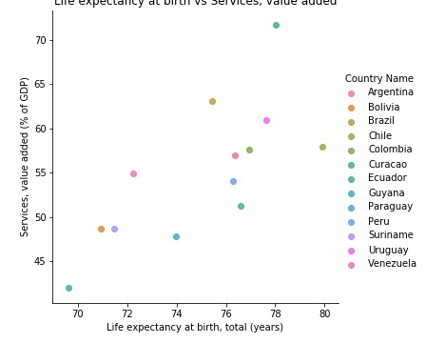
Services (% of GDP) x Life expectancy at birth (years)

Slide 42
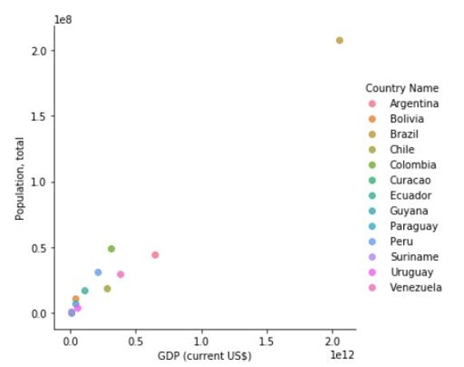
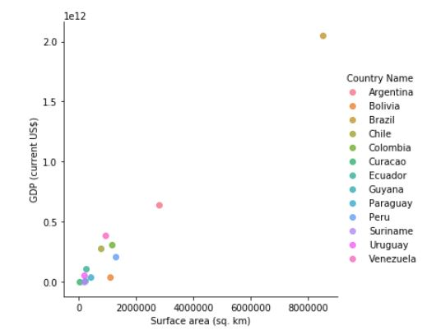
GPD x
Population, total & Surface area

Slide 43
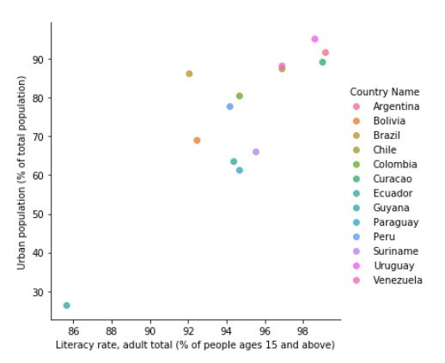
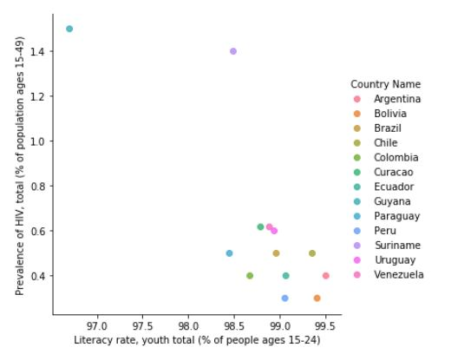
Literacy rate, adult x Urban population &
Literacy rate, youth x Prevalence of VIH

Slide 44
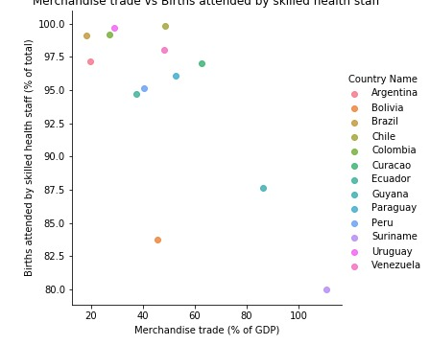
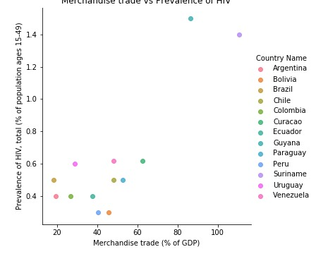
Births attended by skilled health staff (% total) x Merchandise trade (% of GDP)
& Prevalence of HIV (% population 15-49) x Merchandise trade (% of GDP)

Slide 45
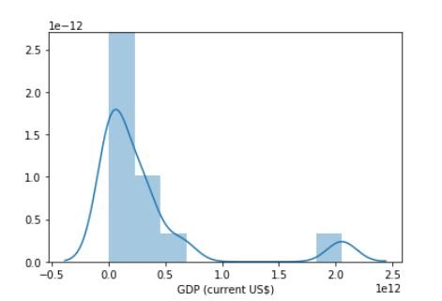
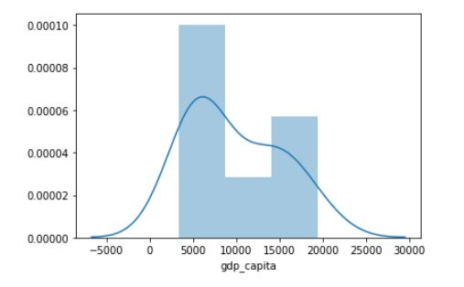
Normal distribution of the
GDP per capita & GDP

Slide 46
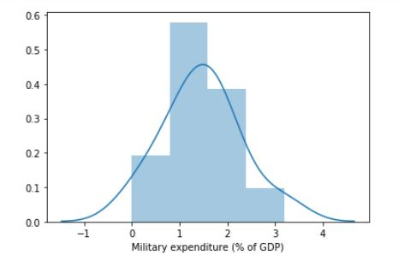
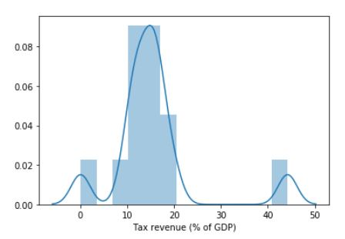
Normal Distribution of
Military Expenditure & Tax Revenue

Slide 47
Regressions

Slide 48
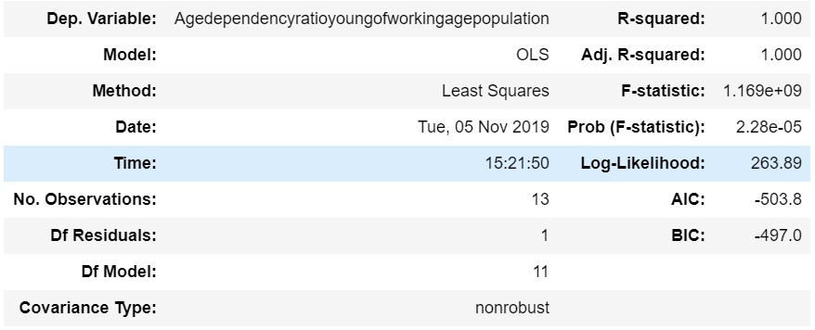
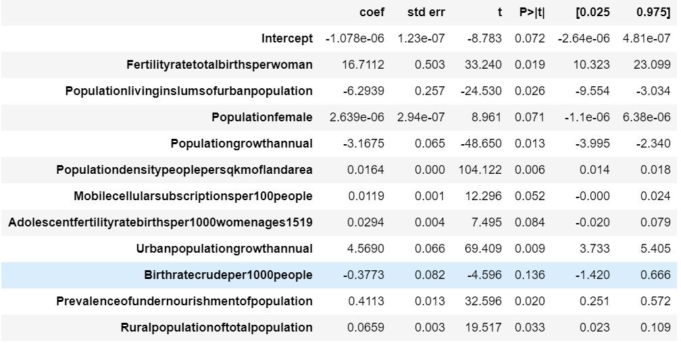
Regression analysis
Age dependency ratio, young (working age population)

Slide 49
Countries

Slide 50
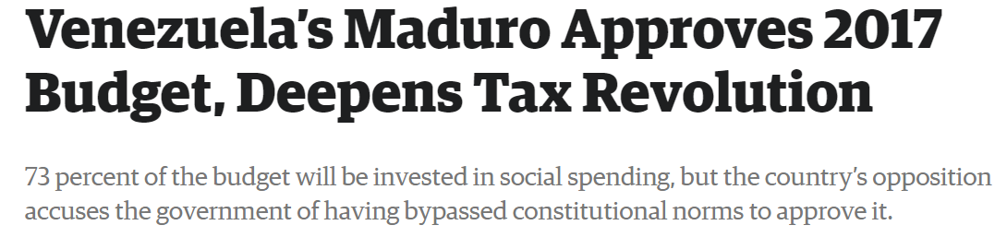
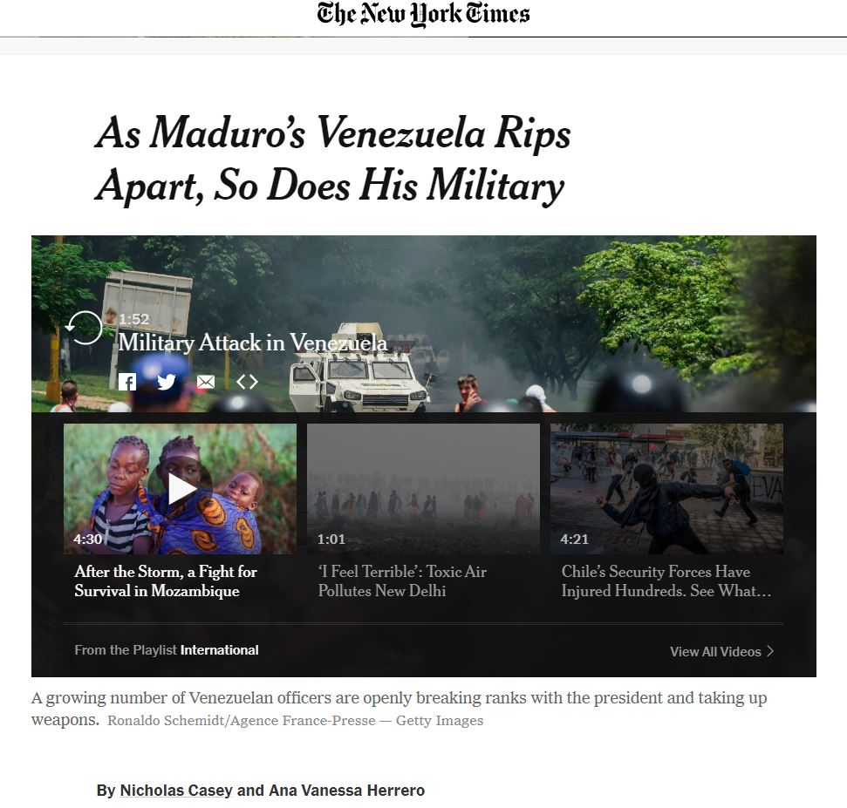
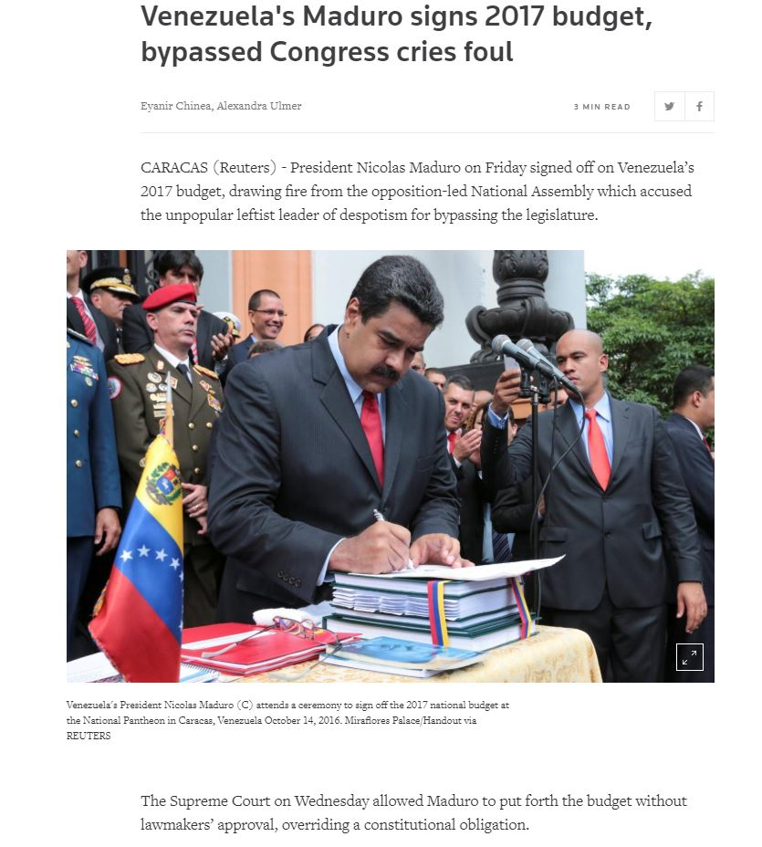
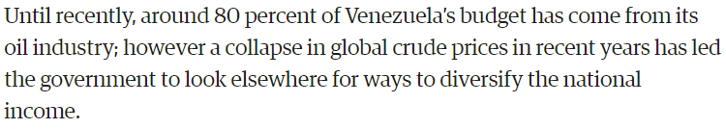
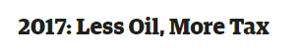
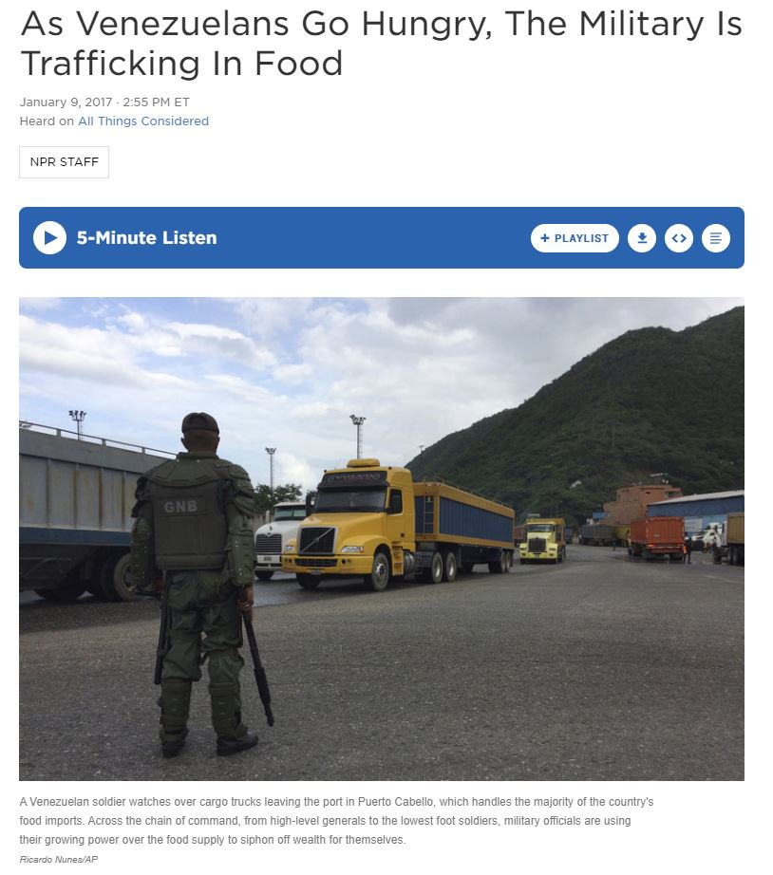
Venezuela
Appendix

Slide 51
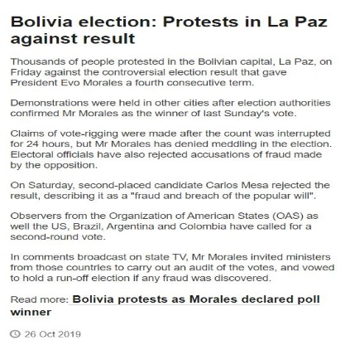
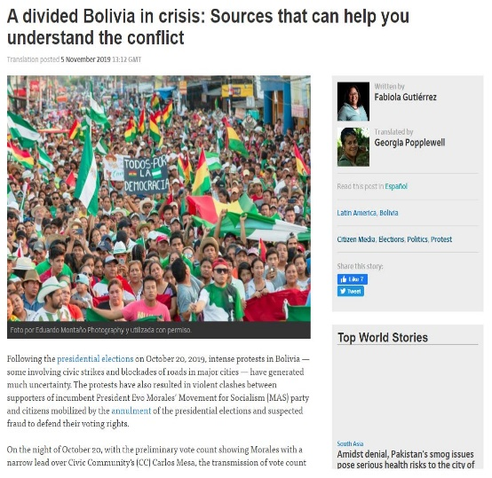
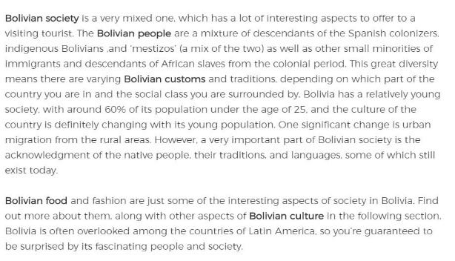
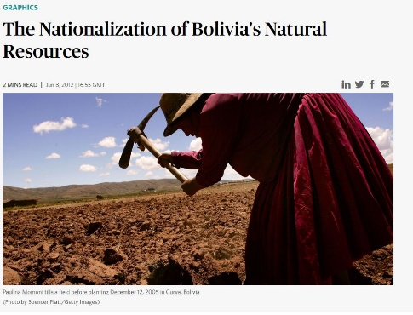
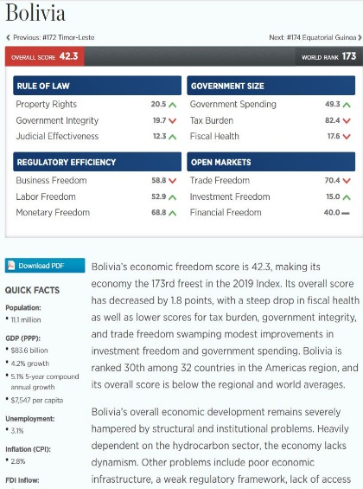

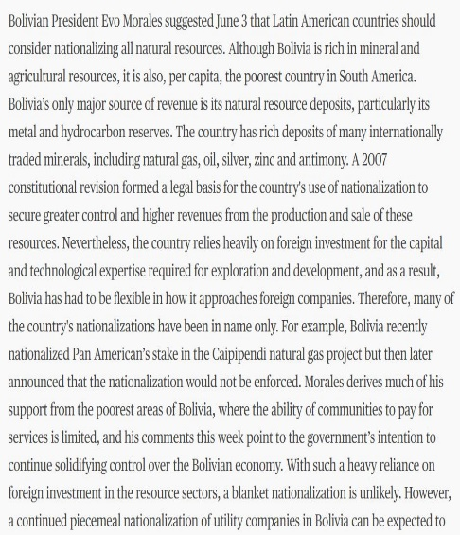
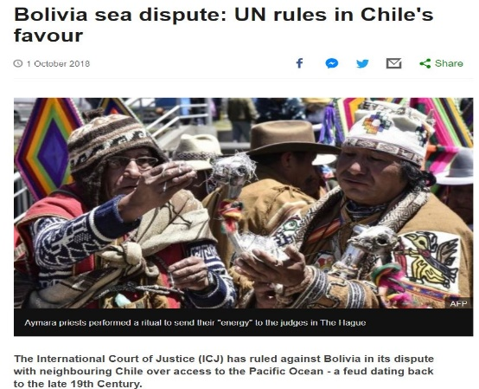
Bolivia
Appendix

Slide 52
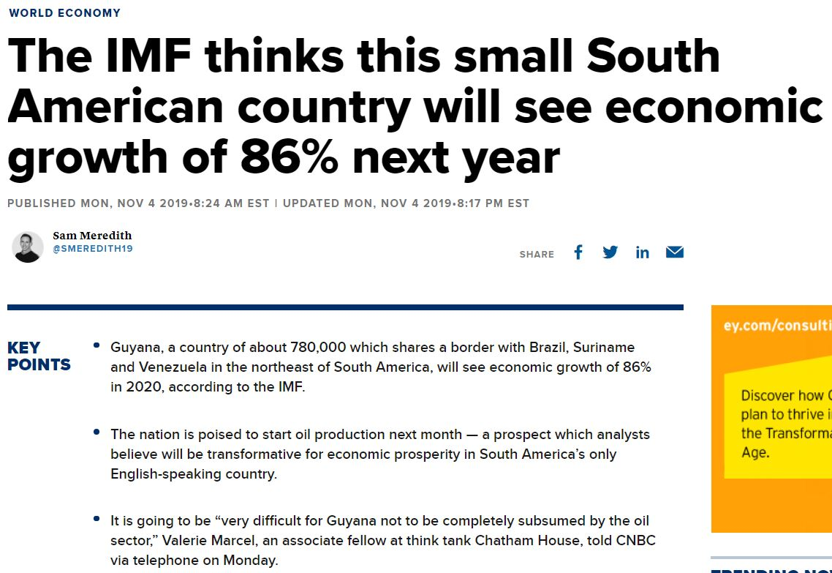



Guyana
Appendix

Slide 53




Suriname
Appendix

Slide 54
References

Slide 55
Bolivia news:
https://www.bbc.com/news/av/world-latin-america-50196181/bolivia-election-protests-in-la-paz-against-result
https://www.washingtonpost.com/opinions/2019/10/14/how-evo-morales-running-again-again-undermines-bolivias-democracy/
https://globalvoices.org/2019/11/05/a-divided-bolivia-in-crisis-sources-that-can-help-you-understand-the-conflict/
https://worldview.stratfor.com/article/nationalization-bolivias-natural-resources
https://www.bbc.com/news/world-latin-america-45708671
https://www.donquijote.org/bolivian-culture/traditions/
https://www.heritage.org/index/country/bolivia
Venezuela news:
https://www.aljazeera.com/indepth/features/2017/04/venezuela-happening-170412114045595.html
https://www.nytimes.com/2017/08/08/world/americas/nicolas-maduro-venezuela-military.html
https://www.npr.org/sections/thesalt/2017/01/09/508986586/as-venezuelan-go-hungry-the-military-is-trafficking-in-food
https://venezuelanalysis.com/news/12724
Guyana news:
https://www.cnbc.com/2019/11/04/guyana-the-imf-thinks-this-country-will-see-growth-of-86percent-in-2020.html
https://www.indexmundi.com/facts/guyana/merchandise-trade
https://borgenproject.org/education-in-guyana/
https://www.export.gov/article?series=a0pt0000000PAtvAAG&type=Country_Commercial__kav
Suriname news:
https://www.csis.org/analysis/surinames-economic-crisis
https://www.britannica.com/place/Suriname/People
https://www.britannica.com/place/Suriname/Government-and-society#ref29846
https://energypedia.info/wiki/Suriname_Energy_Situation#Electricity
Peru Education: https://www.oecd.org/dev/inclusivesocietiesanddevelopment/youth-issues-in-peru.html
Argentina: https://www.macrotrends.net/countries/ARG/argentina/unemployment-rate

Slide 56
Missing values for data base
https://data.unicef.org/topic/maternal-health/delivery-care/
https://english.defensie.nl/organisation/navy/navy-units/dutch-naval-command-caribbean
https://lac.unfpa.org/sites/default/files/pub-pdf/MSH-GTR-Report-Eng.pdf
https://www.cia.gov/library/publications/the-world-factbook/geos/cc.html
https://www.cbs.cw/website/labour_3361/item/labour-tables-2018_1192.html
https://www.financialsecrecyindex.com › EXCEL › Curacao
https://unstats.un.org/unsd/publications/statistical-yearbook/files/syb61/T09_Edu_Expend.pdf
https://www.macrotrends.net/countries/CUW/curacao/literacy-rate
https://www.worldometers.info/world-population/curacao-population/
http://devinit.org/wp-content/uploads/2019/01/Filling-the-gaps-in-current-global-poverty-data-estimates.pdf
https://curacaochronicle.com/local/quarter-of-households-below-the-poverty-line/
https://www.cia.gov/library/publications/the-world-factbook/geos/cc.html
https://www.imf.org/external/pubs/ft/scr/2016/cr16276.pdf
https://www.cia.gov/library/publications/resources/the-world-factbook/geos/gy.html
http://www.fao.org/ag/agn/nutrition/guy_en.stm
https://www.indexmundi.com/facts/indicators/SH.STA.MALN.ZS/compare?country=gy
https://stats.oecd.org/Index.aspx?DataSetCode=REVGUY
http://uis.unesco.org/en/country/sr?theme=education-and-literacy
https://knoema.com/atlas/Suriname/topics/Education/Literacy/Adult-literacy-rate
https://www.worldometers.info/world-population/suriname-population/
https://theodora.com/wfbcurrent/suriname/suriname_economy.html
https://www.cia.gov/library/publications/the-world-factbook/geos/ve.html

Slide 57
Outliers
Peru Education: https://www.oecd.org/dev/inclusivesocietiesanddevelopment/youth-issues-in-peru.html
Argentina: https://www.macrotrends.net/countries/ARG/argentina/unemployment-rate
Chile: https://www.accdis.cl/eng/en/esperanza-de-vida-en-chile-llega-a-los-805-anos-la-mas-alta-de-latinoamerica/
Columbia: https://colombiareports.com/colombia-has-4th-highest-business-tax-rates-in-the-world/

